Slide 1
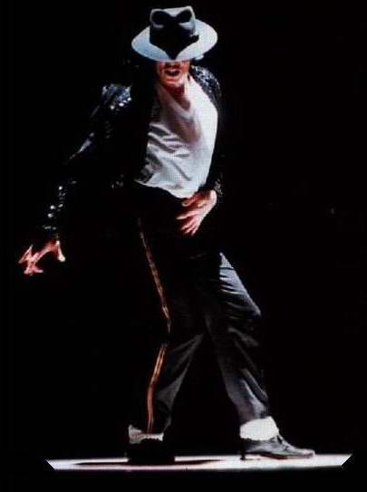
Apply Page-Rank on Wikipedia Singers
Daniele Buonadonna, Eleonora Lopez, Umberto di Canito

Slide 2



Contributions
■ Daniele: SPARQL queries, Dataset creation (based on queries), first method PageRank
■ Eleonora: Named Entity Recognition, second method PageRank
■ Umberto: Dataset creation (based on scraping Wikipedia pages), retrieving “influences” section

Slide 3
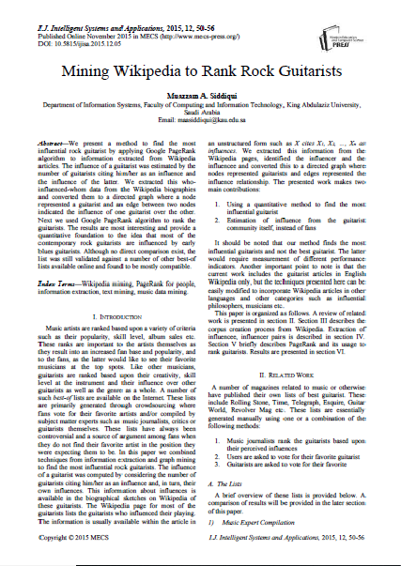
Reference paper
Muazzam A. Siddiqui
Mining Wikipedia to Rank Rock Guitarists
International Journal of Intelligent Systems and Applications (IJISA),
vol.7, no.12, pp.50-56, 2015. DOI: 10.5815/ijisa.2015.12.05

Slide 4
Reference paper - main ideas
Find the most influential rock guitarists
Use quantitative method instead of subjective opinions of people
Compute graph by analyzing data from the guitarist himself
Finally, compute PageRank and compare the results to major ranking lists available online

Slide 5
Our project - main ideas
Replicate the paper by finding the most influential singers
Dataset is computed by SPARQL queries (to retrieve singers’ name and bands’ name) and by scraping the Wikipedia pages of each singer
Results are computed using two different methods:
Blind meta-data link picking
“Influences” section analysis

Slide 6
Dataset construction
Retrieve all the singers and bands from DBPedia
Associate each singer to his bands in order to consider the band’s influence
Download each wikipedia page associated to each singer
Python scripts are being used in order to provide the lists and download the pages, resulting in 4581 different singers and 2471 different bands.
SPARQL queries
Lists of singers and bands
List of bands associated to each singer
Download of Wikipedia pages

Slide 7
Methods used
Blind meta-data link picking
Consider link structure between Wikipedia pages of singers to build directed graph
Hypothesis: if there exists a link from page of singer s1 to page of singer s2 then s1 was influenced by s2
“Influences” section analysis
Scraping of Wikipedia singers’ pages to get “influences” section
Apply NER (Named Entity Recognition) to get singers and bands mentioned in the “influences” section
Hypothesis: if singer s2 is mentioned in the “influence” section of singer s1 then s1 was influenced by s2

Slide 8
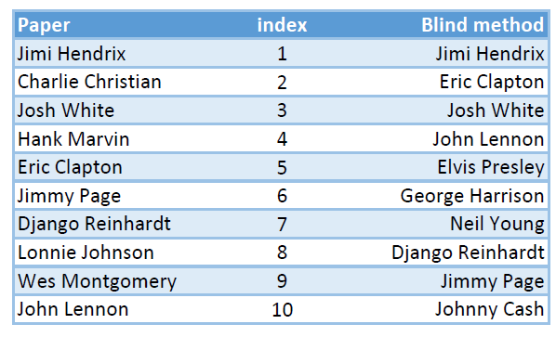
Is the “blind” method reliable?
Compared PageRank result of our method to the result of the reference paper.

Slide 9
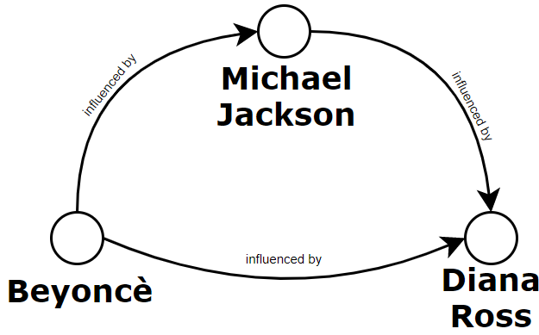
The graph
There is a node for every singer in the list
There is an edge from singer s1 to singer s2 if s1 was influenced by s2

Slide 10
Other hypotheses
If a singer is considered to be influenced by a band
For the second method, if a singer does not have the “influences” section
then we consider such singer to be influenced by the band’s singers
then we consider such singer to not have influences

Slide 11
Index | Blind method (1st) | Scraping method (2nd) | The Rolling Stone | Ranker.com | thetoptens.com
1 | Elton John | Michael Jackson | Aretha Franklin | Michael Jackson | Michael Jackson
2 | Michael Jackson | Aretha Franklin | Elvis Presley | Frank Sinatra | Elvis Presley
3 | Elvis Presley | James Brown | John Lennon | Elvis Presley | Freddie Mercury
4 | Frank Sinatra | Diana Ross | Marvin Gaye | Aretha Franklin | John Lennon
5 | David Bowie | Madonna | James Brown | Adele | Madonna
6 | John Lennon | David Bowie | Little Richard | Elton John | David Bowie
7 | Eric Clapton | Celine Dion | Mick Jagger | Celine Dion | Paul McCartney
8 | Bruce Springsteen | Mariah Carey | Bob Marley | John Lennon | Whitney Houston
9 | Madonna | B.B. King | Johnny Cash | David Bowie | Mariah Carey
10 | Mick Jagger | John Lennon | David Bowie | Marvin Gaye | Kurt Cobain

Slide 12
Discussion of results
Results are quite different for each list but compatible
It is not easy to make a comparison since we do not know the criteria used by the creators of the online lists
We expected that the scraping method would perform better than the blind method but in the end they both yielded good results
Elvis Presley appears in all the lists except the scraping method’s list, the reason is that the singers influenced by Presley are not many and not so important

Slide 13

Libraries used
Dataset building
Defining graph
Page Rank computation
SPARQL Wrapper
https://pypi.org/project/SPARQLWrapper/
HTMLParser
https://pypi.org/project/HTMLParser/
Networkx 2.3
https://pypi.org/project/networkx/
PyWebCopy 6.0.0
https://pypi.org/project/pywebcopy/
StanfordCoreNlp
https://pypi.org/project/stanfordcorenlp/
Wikipedia-API 0.5.1
https://pypi.org/project/Wikipedia-API/

Slide 14
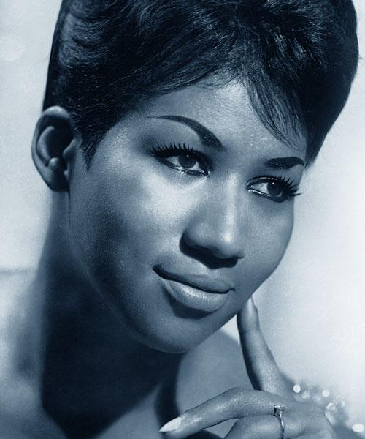
Thank you

